Slide 1
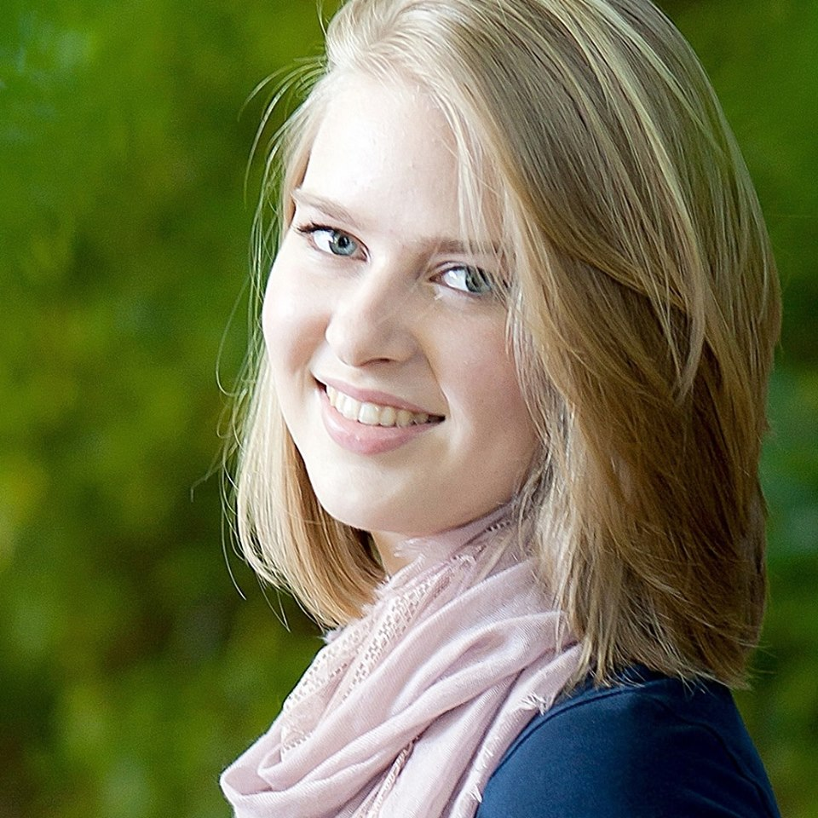
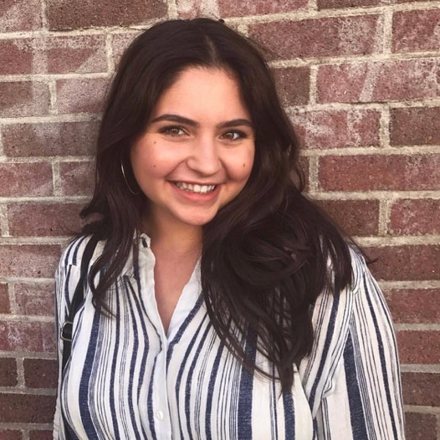
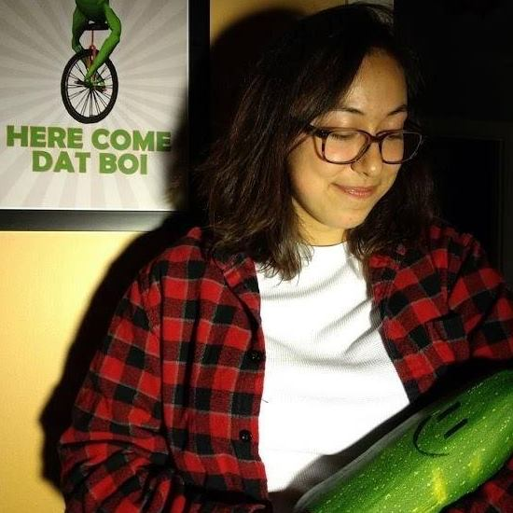
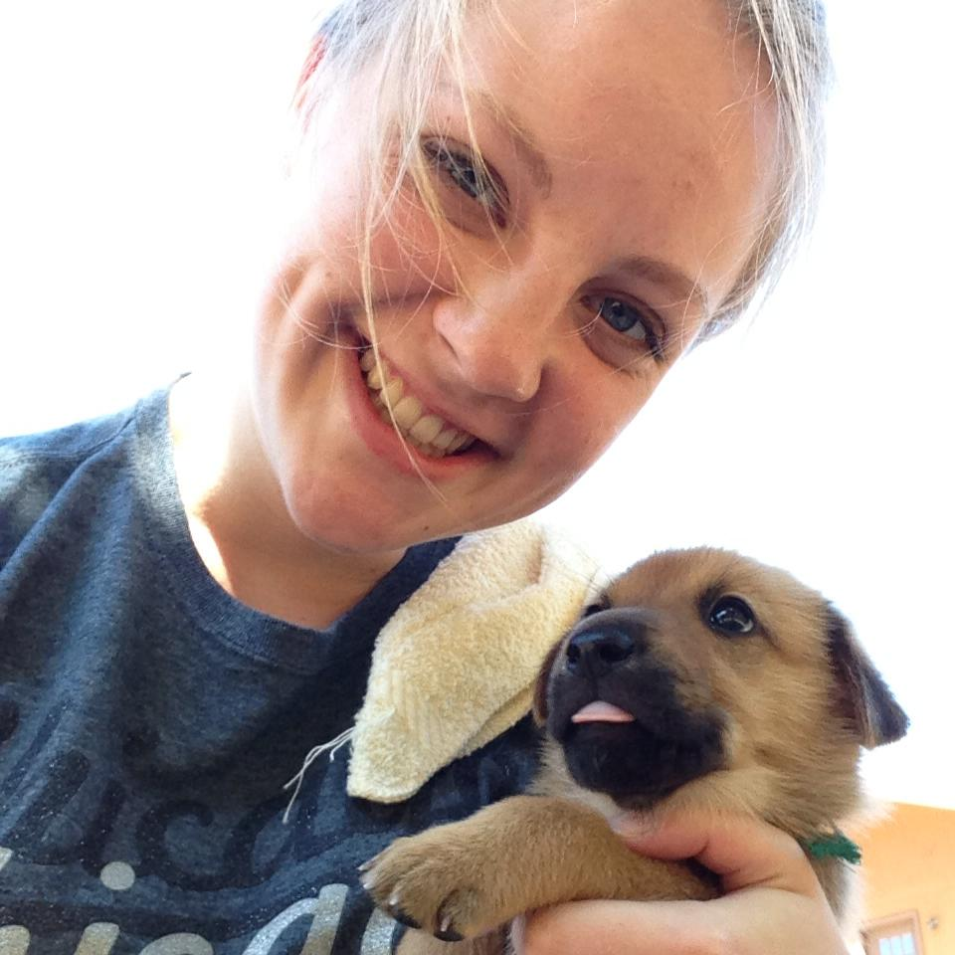
Cake Catalog
i
Meet your Cake Consultants!
Cake
Catalog
Amanda Crawford
Talia Moretty
Favorite Cake:
Yellow cake with chocolate frosting
Other info:

